Slide 1

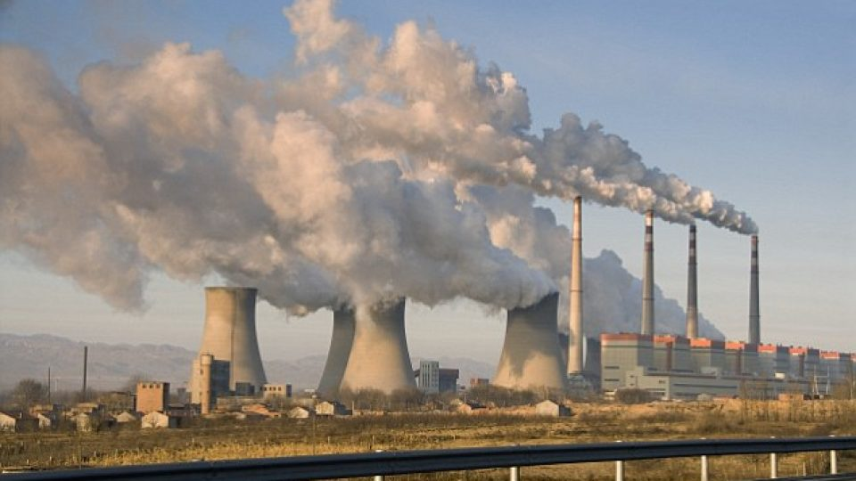
Environmental Pollution causes, effects and control with emphasis on Islamic perspective
By :
Engr. Syed Mubashir H. Kirmani
Former Chairman I.E.P (SAC)
Chief Engineer & Technical Advisor
Saudi Technical Limited (STL) smhkirmani@gmail.com
November 22nd, 2019
Riyadh, Saudi Arabia
INSTITUTION OF ENGINEERS PAKISTAN
SAUDI ARABIAN CENTER (IEP-SAC)

Slide 2
CONTENTS
  Introduction
  Atmosphere and Environment
  Environmental Pollution, its causes and effects
  Prevention and Control
  Islamic Perspective to control
  Conclusion

Slide 3
1) Introduction:
بسم الله الرحمن الرحيم
Scientific perspective of Environmental Pollution:
Contamination in environmental component causing adverse effects on natural ecological balance and environmental process.
According to Quranic perspective the environment is created and owned by Allah (S.W.T)
Quran Verse(s): 64:22:
To Him belongs all that is in the heavens and all that on the earth and verily Allah is RICH (free of all wants), worthy of all praise.
Allah SWT warned human beings (57:7)
“Do not mischief on earth, after it has been set in order”.

Slide 4
Introduction (Cont.)
All catastrophes in environment are “self inflicted”:
Quran (41:30):
“Corruption (Evil) has appeared throughout the land and sea by (reason of) what the hands of people have earned. So He may let them taste part of (consequences of) what they have done, perhaps they will return (to righteousness).”

Slide 5
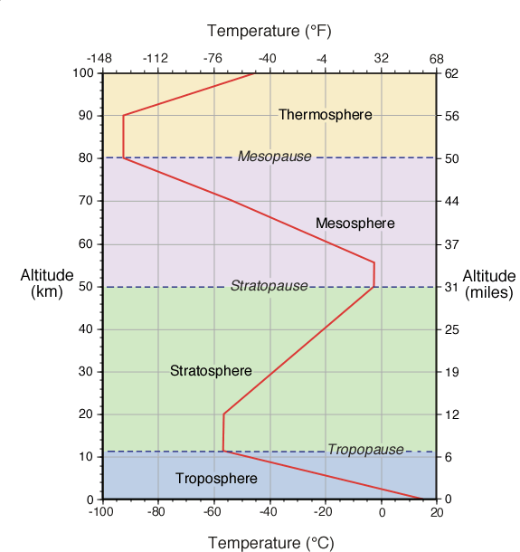
Atmosphere
Atmosphere is composed of 4 different layers.
Troposphere: 8-16 Km (Ave: 11Km)
2) Stratosphere: (Ozone Layer) 11-50 Km
Holy Quran 1500 years ago mentions the atmosphere in embracing language. Quran(21:32): “And we made the sky a protecting ceiling (canopy), but they, from it signs, are turning away”.
Figure: 1

Slide 6
Atmosphere: (Cont…)
Ozone layer as a green carpet, Scientific finding:
Hadis # 456, Volume 4, Sahih Bokhari narrated by Abdulla, “Regarding the verse, indeed he (Prophet PBUH) did see of the sign of His Lord, The Greatest (18/53) that Prophet had seen a green carpet all over the horizon of the sky
(www.anserwing-chritianity.com/ozonelayer-protecting-earth.htm)
3) Mesosphere: (From 50 – 80 Km)
4) Thermosphere: (80 to 100 Km)
Figure: 1

Slide 7
Environment: (Cont…)
The word “Environment” literally refers to everything that encloses and surround people. (New Oxford Dictionary P-266)
The concept of Environment in Qura’n refers to the word “Ma’ayish” (TO RESIDE). (Ref: The Environmental dimension of Islam, PP: 24, by Dr. MAWILIZZI Dien (200)).
Quran:(38:6) “There is not an animal in the earth, nor a creature on two wings but they are nations like you.”
It is through these relationship that Allah (S.W.T) has forbidden the misuse or abuse of nature. (Quran 41:30).

Slide 8
Environment:(Cont…)
Allah has created the universe in “Balance” and without any fault.
“FAULT”.
Ibn-e-Kathir quoted the views of Ibn-e-Abbas by stating the verse “so turn your vision again, do you see any flaw” is referring to meaning of “damage” or breakdown.
Therefore human beings need to fulfill their role in maintaining and guarding this balance.
QURAN (3:67): “Who has created seven heavens one above another, You can see no fault in the creations of the most gracious. Then look again:”Can you see any RIFTS (FLAWS)”.
Quran: (49:54) “ Surely we have created everything with destiny (predestined) ”.

Slide 9
Environmental Pollution and its sources
Types of Pollution:
Air Pollution
Water Pollution
Soil Pollution
Noise Pollution
Thermal Pollution
Radioactive Pollution

Slide 10
Air Pollution:
Air is vital for survival of life.
99% of air is made up of N2,O2, Water
Vapor & inert gases.
Sources of Air Pollution:
Human Induced Sources:
INDUSTRY and power plants (F.F.C.).
Transport (F.F.C.).
Agriculture particles (Emission of NH3).
Household Energy
Waste Management (land fills or incinerators).
Deforestation (Leading to less O2 & exceeding-CO2)

Slide 11
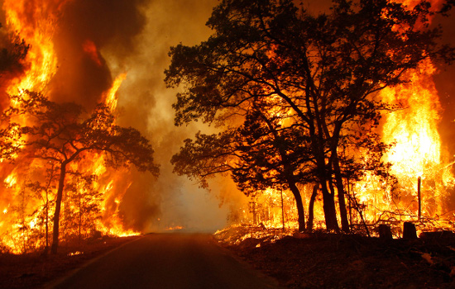
Sources of Air Pollution: Cont…
Natural Causes:
Forest Fires (Human induced & Natural causes).
Fire blazing across the Amazon rain forest, popularly known as “Lungs of the planet”.
Only in 1 week Aug 2019 about 9400 blazes spotted, so far this year about 73000 fires are recorded.
Forest Fires causes 32% of global carbon mono oxide
10% of methane emission, 86% of soot emission
Upto 4.1 billion tons of CO2 annually
15% of the global GHG emission are attributed to forest fires.

Slide 12
B) Natural Causes: (Cont...)
ii) Erupting Volcanoes:
Volcanic eruption is extremely damaging to the environment, Lava, Ash & fragments contain:
CO2: Adds to green house effect
(According to British Geological survey about 300m tons of CO2 is released every year)
SO2 (This causes acid rain), H2S, HCL, Carbon Mono oxide & Volatile metal chloride.
iii) Gases released from radioactive decay of rocks inside earth.
Such radioactive decay emits harmful ionizing radiation such as Alpha particles, Beta particles and gamma rays. The degree of hazard is determined by the concentration of the contaminants.

Slide 13
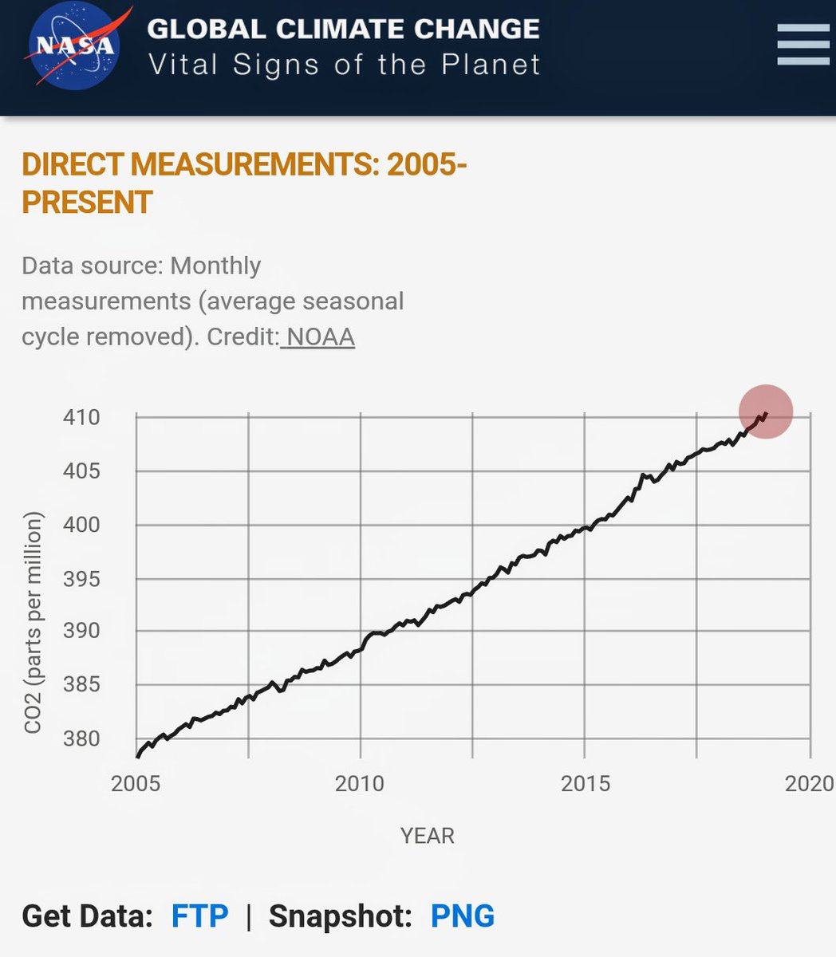
Top 8 Gases Causing Air Pollution:
i) Carbon Dioxide (CO2):
CO2 spreads around the planet like a blanket and responsible for absorption of infrared radiation which comprises the bulk of solar energy.
List report of MAUNA 20A observatory NASA , USA CO2 > 415 ppm, highest in 650,000 years.(see graph).

Slide 14
Top 8 Gases Causing Air Pollution: Cont..
ii) Sulphur Dioxide(SO2): Emitted from coal fired power plants contributes to Smog, Acid rain – eventually health problems.
iii) Carbon monoxide: This is highly toxic gas resulted from incomplete combustion of fuels from automobiles, Gas boilers and other fuel burning appliances.
iv) Nitrogen Oxide (NO2): NO2 pollution comes from “vehicle engines” and power plants. Plays an important role in the formation of “acid rains”,“Ozone” and “Smog”.

Slide 15
Top 8 Gases Causing Air Pollution: Cont..
v) Volatile Organic Compounds (VOCs):
Carbon based (organic) chemicals used as solvent in many building materials.
vi) Particulate Matters (PM):
The term is used for a mixture of solid particles and liquid droplets found in the air.
PM2.5: Fine inhalable particles having dia.≤ 2.5 micrometers.
PM10: Fine inhalable particles having dia. ≤ 10 micrometers.
Most PM 2.5 and PM 10 come from traffic and industrial smoke.

Slide 16
Top 8 Gases Causing Air Pollution: Cont..
vii ) Unburned Hydrocarbons:
Responsible for smog & CO emission.
viii) Radioactive Pollution:
Radioactive Pollution is rare but extremely detrimental and even deadly,
when occurs.
Sources:
Nuclear Power Plant: Accidental leakage
Improper Nuclear waste disposal
Uranium Mining operations.

Slide 17
WHO Air-Quality Guidelines
Particulate matter (PM): The term is used for a mixture of solid particles & liquid droplets found in air, particulate pollution include:
PM 2.5 : 10 microgram / m3, annual mean
          25 microgram / m3, 24 hours mean
PM 10 : 20 microgram / m3, annual mean
          50 microgram / m3, 24 hours mean
Earth Surface Ozone (O3) : 100 microgram / m3, 08 hours mean
iii) Nitrogen Dioxide (NO2) : 40 microgram / m3, annual mean
          200 microgram / m3, 01 hour mean
iv) Sulphur Dioxide (SO2) : 20 microgram / m3, 24 hours mean
          500 microgram / m3, 10 hours mean

Slide 18
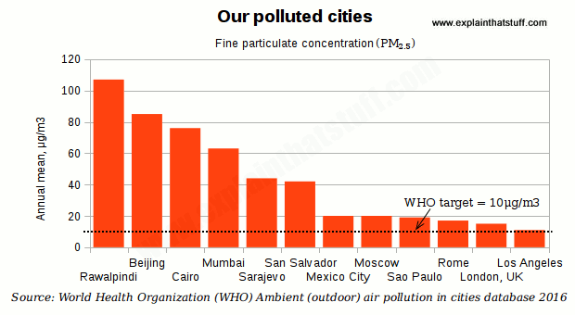
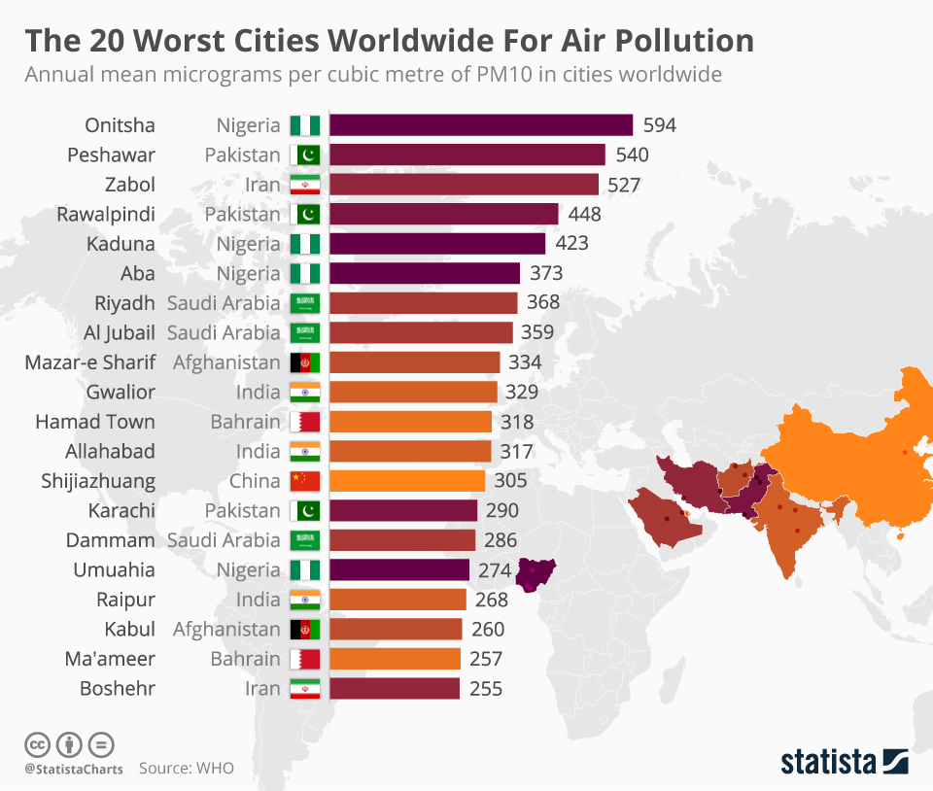
WHO Ambient Air pollution in various cities of the world

Slide 19
Average PM 2.5 concentration in micro g/m3 as the estimation of population’s average exposure (Source: US air quality index). Effect of air pollution on health.
Country | 2018 air quality *
Bangladesh | Unhealthy 97.1
Pakistan | Unhealthy 74.27
India | Unhealthy 72.54
Afghanistan | Unhealthy 61.8
Bahrain | Unhealthy 59.8
Mangolia | Unhealthy 58.5
Kuwait | Unhealthy 56
Nepal | Unhealthy for sensitive groups 54.15
United Arab Emirates | Unhealthy for sensitive groups 49.93
Nigeria | Unhealthy for sensitive groups 44.84
Indonesia | Unhealthy for sensitive groups 42.01
As air quality declines the risk of stroke, heart diseases, lung cancer and chronic and acute respiratory diseases including Asthma increases. WHO reports 07 Million deaths in every year from exposure to PM 2.5 CONCENTRATION.

Slide 20
2. Effect of Air pollution on Global warming & climate change:
Since the industrial revolution, the effect of additions of green house gases to the atmosphere has been over 50 times more powerful than changes in the sun’s radiance. Global CO2 emission in 2018 reached a new record of 37.1 Billion Tons.
Main GHG responsible for global warming and climate change are:
CO2:
Surface-level Ozone(O3):
Water vapor:
Nitrous oxide:

Slide 21
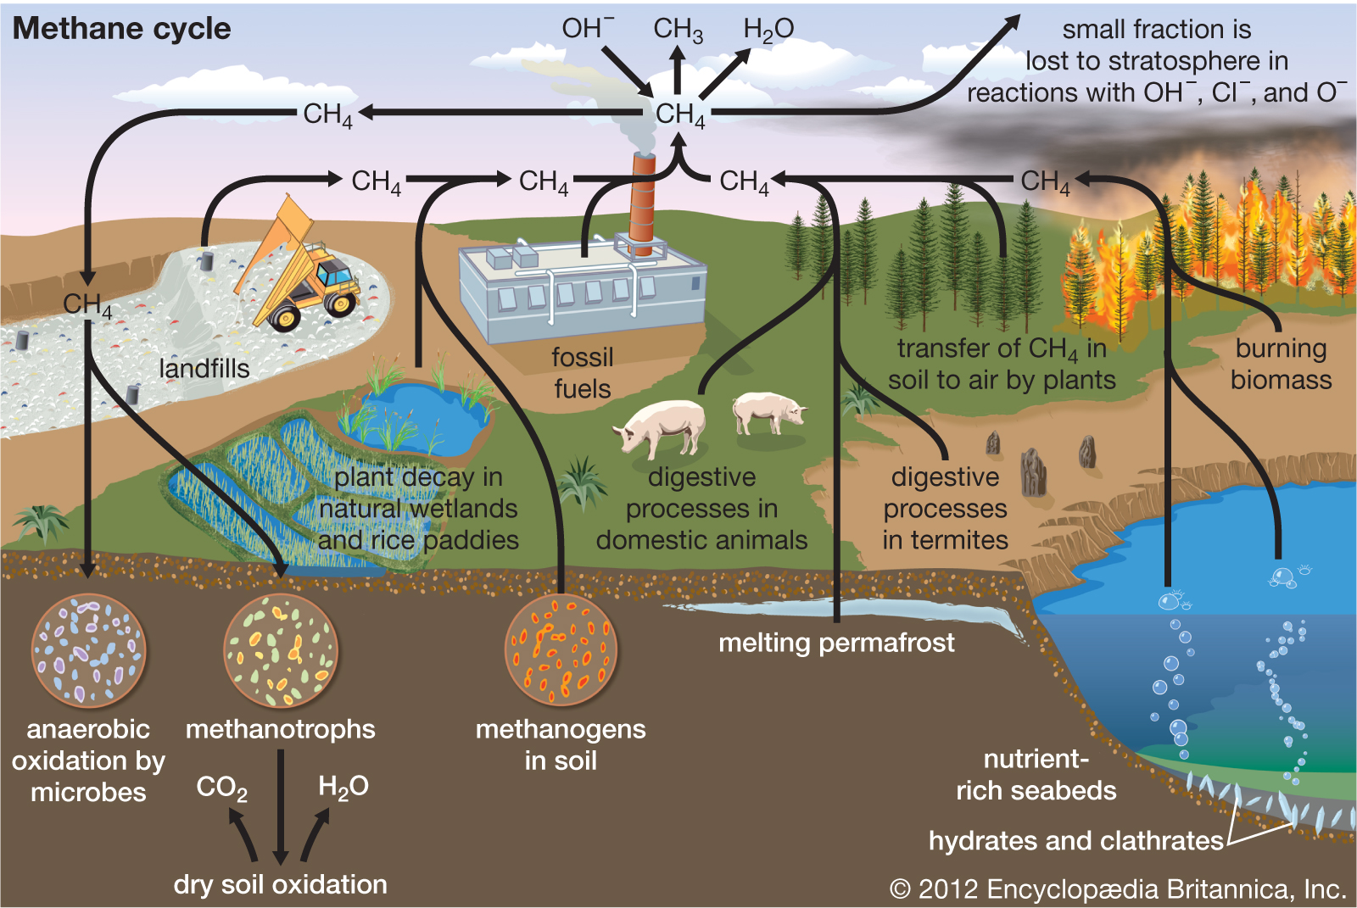
2. Effect of Air pollution on Global warming & climate change: Cont..
5. Methane (CH4):
About 60% of Methane in the atmosphere is from human induced causes. There is not much part of CH4 in the atmosphere about 1800 ppb. About 200 times less concentration than CO2.

Slide 22
Top 6 countries contributing to global pollution (GHG)
Between 2010 to 2017 total global emission of CO2 has increased from 33.1 Giga ton to 36.2 Giga tons.
Country | % of contribution | Total global emission of CO2
CHINA | 30% | 9.04 Billion Tons
USA | 15% | 5.00 Billion Tons
INDIA | 07% | 2.07 Billion Tons
RUSSIA | 05% | 1.47 Billion Tons
JAPAN | 04% | 1.14 Billion Tons
GERMANY | 2.56% | 729.7 Million Tons

Slide 23
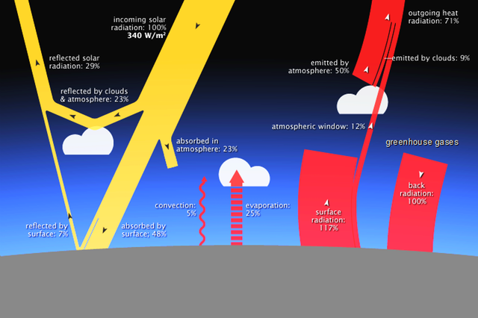
Green House Effect on Earth
Global warming: Earth constantly receives energy from the sun &radiates back
into space.
Intergovernmental panel on climate change (IPCC) reported in 2018 an average temperature increase of b/w 0.8-1.2 °C since preindustrial time.

Slide 24
Green House Effect on Earth Cont…
IPCC noted that should CO2 emissions continue at the present rate, the increase in average near surface air temperature could reach 1.5 ° C sometimes b/w 2030-2050.
Melting of mountain glaciers and sea ice sheets is predicted to lead an increase in global sea level of 45 cm – 82 cm by 2100.
Ocean acidification: Due to increased concentration of CO2 in air, the ocean has become 30% more acidic over the last 150 yrs.

Slide 25
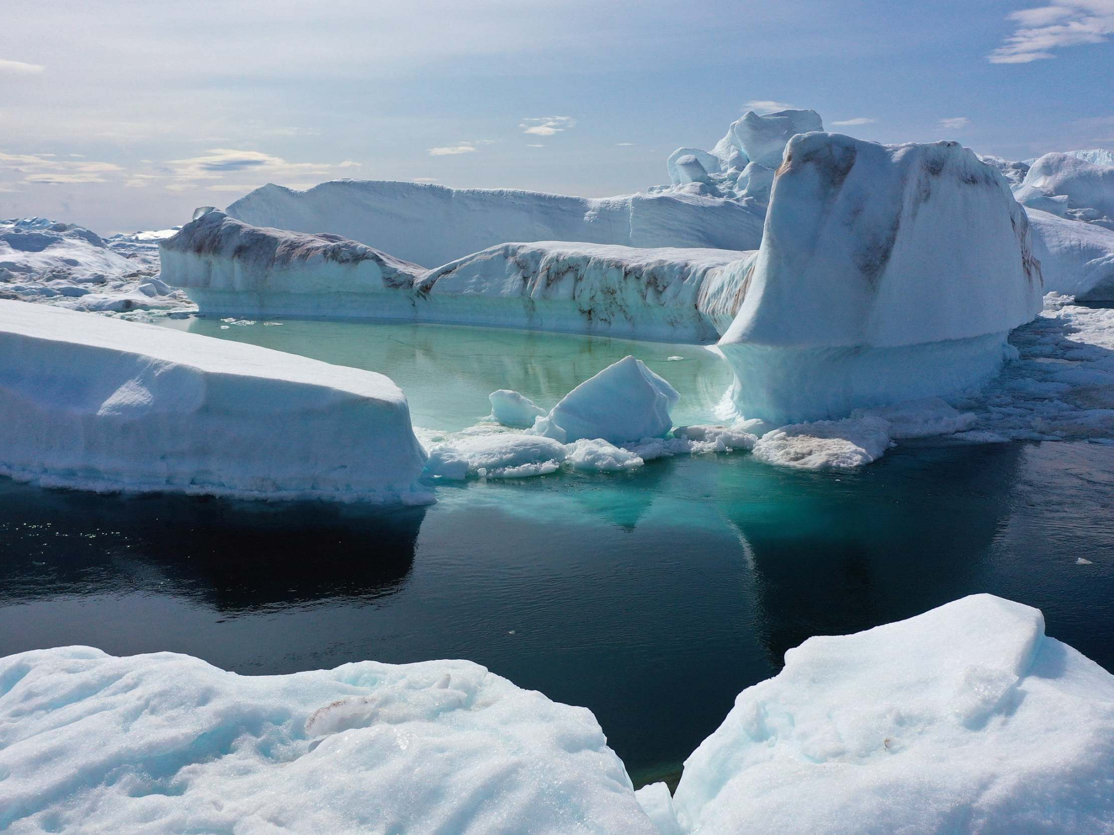
Green House Effect on Earth Cont…
Effect of global warming reached Green Land. In July 2019, 197 billion tons ice melted in Arctic ice sheet & added to Pacific ocean.
In south Hemisphere Antarctica ice cap has a world’s most amazing & famous ice berg, its volume is 78290 cubic km.
On 25th Sept 2019 ice berg break off a huge piece of ice of 315 billion tons.

Slide 26
Effect on Climate Change
Flooding
Changing in precipitation pattern and its intensity.
Droughts
Hurricanes
Biodiversity of plants, animals and other form of life
Socioeconomic impact
Extinction of some plants and animal species

Slide 27
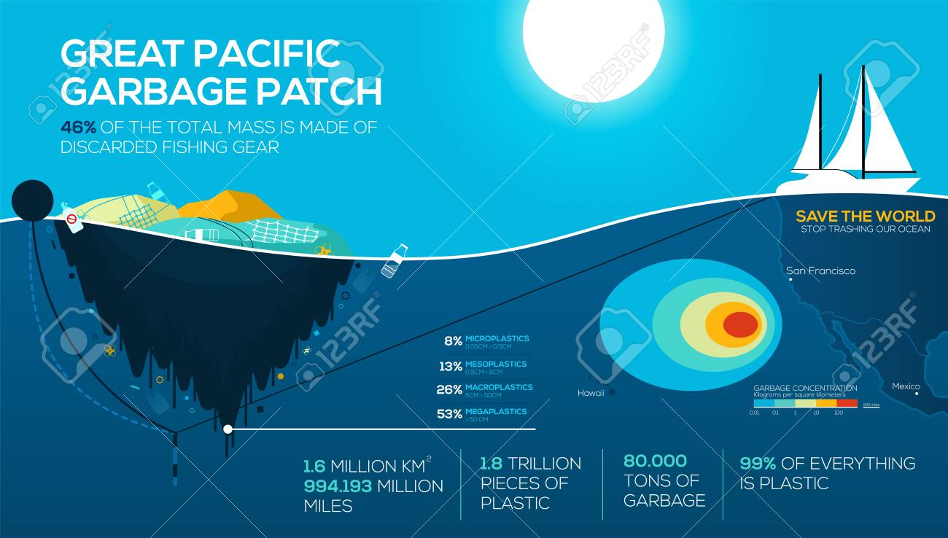
Water Pollution
Main sources of water pollution are:
Organic matter and disease
  causing organisms from waste
  water discharge.
Domestic, Industrial & Agricultural waste.
Plastic pollution- damages the environment.
Radioactive waste–from industrial, medical and scientific processes.
Oil pollution.

Slide 28
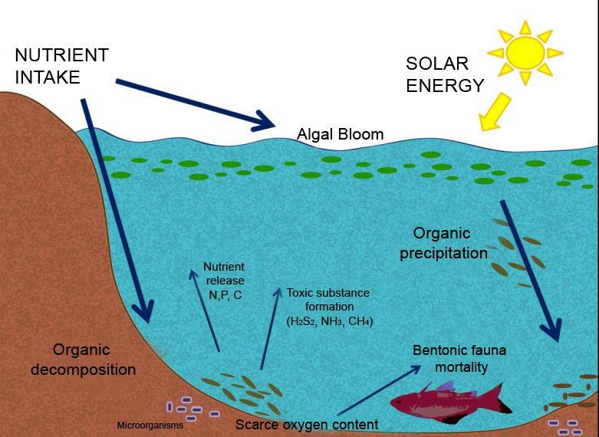
Water Pollution Cont..
vi) Eutrophication- Result of high nutrient load
Effects:
According to WHO: Only 0.007% world’s water is safe for consumption.
1.1 Billion people world wide lack access to fresh water
According to National oceanic and Atmospheric Administration (NOAA), 80% pollution in marine environment comes from the land through run off.
Oil spill makes about 12 % of the oil that enters the ocean.

Slide 29
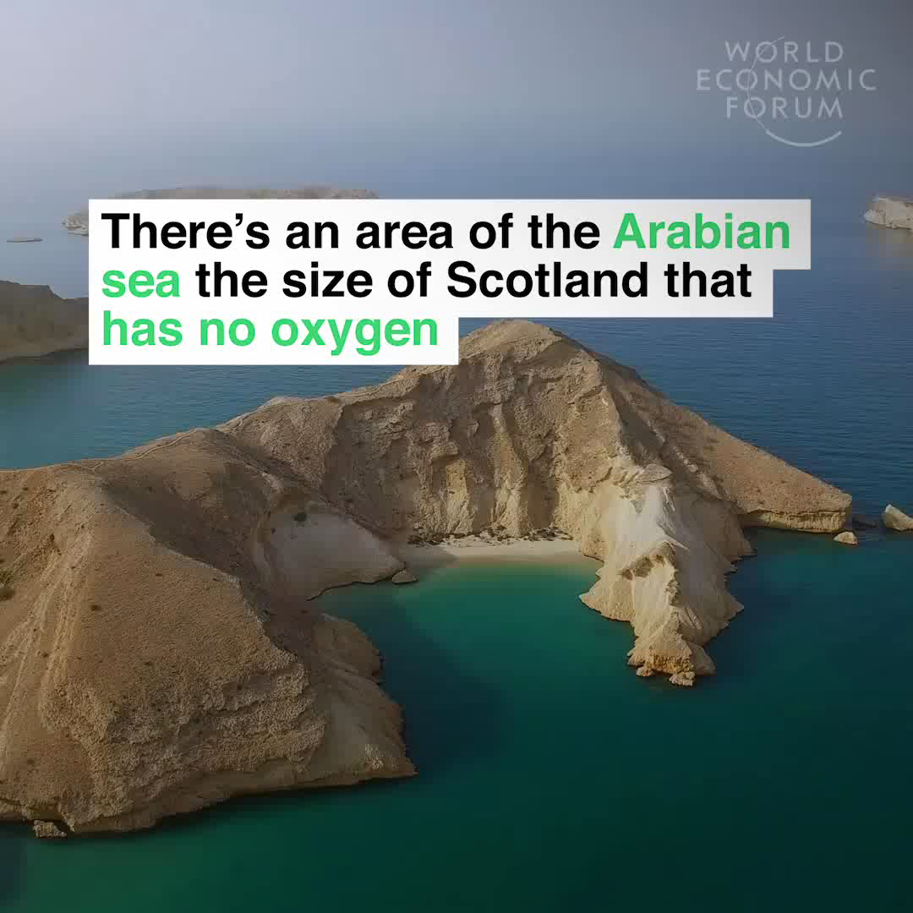

Slide 30
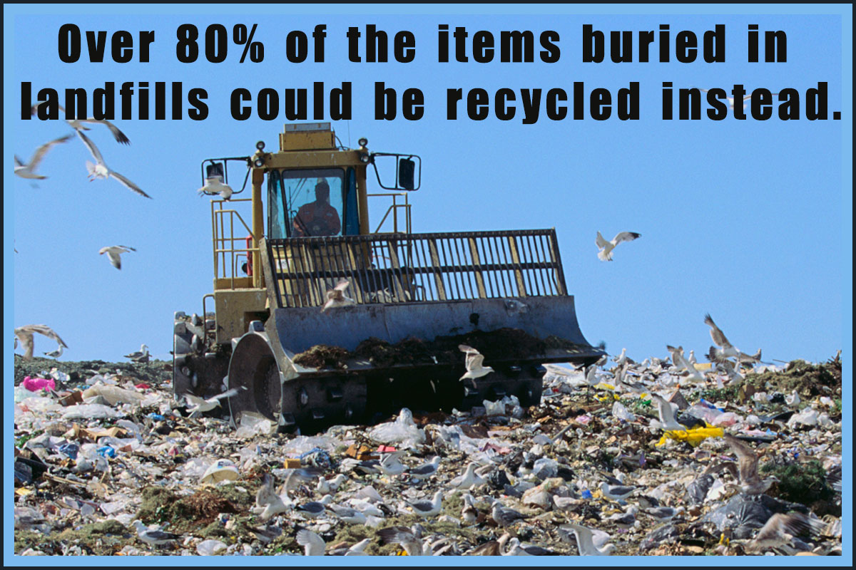
3. Land & Soil Pollution
Human activities responsible for land pollution:
    Deforestation and soil erosion
    Agricultural activities
    Mining Activities
    Overcrowded land fill (Household garbage and industrial waste)
    Sewage Treatment
    Plastic Waste
    Nuclear waste.
Natural factors includes:
    Volcanic eruption
    Changes in rainfall pattern
    Earth quakes
    Topographic changes
    Wind
    Glacier movements

Slide 31
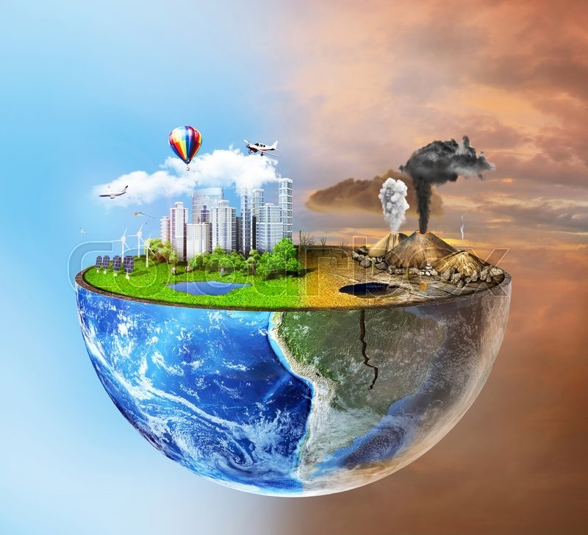
Land & Soil Pollution Cont..
Effects:
  Decrease in soil fertility.
  Changes in climate pattern.
  Loss of ecosystem.
  Increase in salinity of the soil.
  Creation of Toxic dust.
  Pollution due to plastic disposable items.
  Alteration in the soil structure.

Slide 32
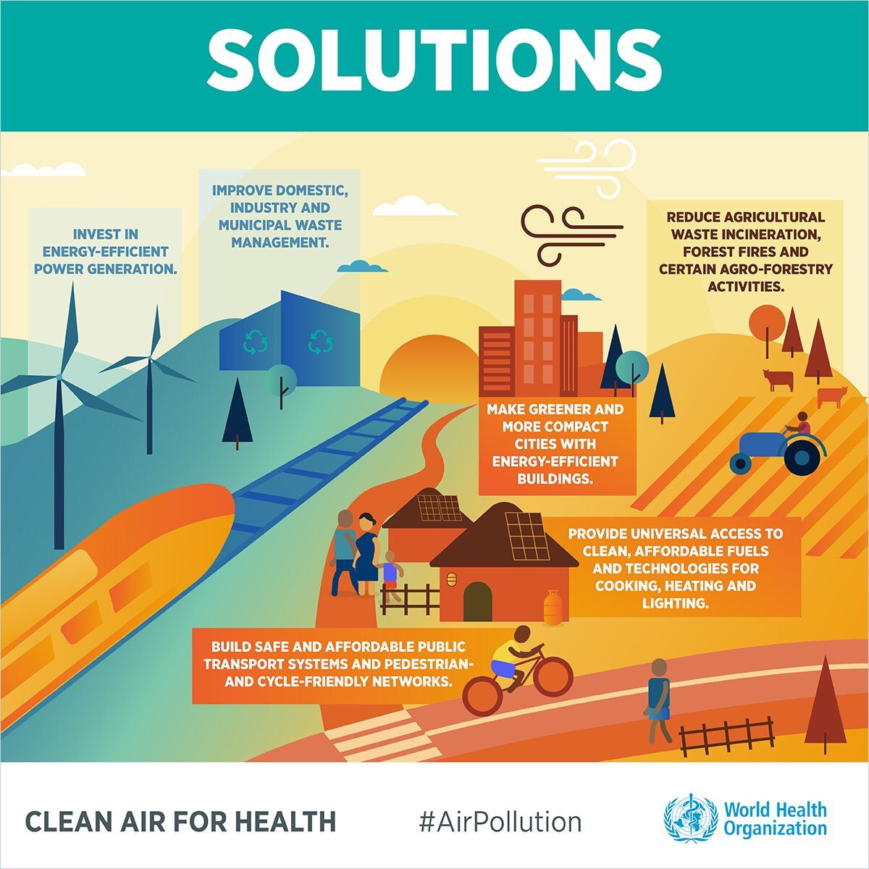
4. Prevention and Control Cont..
To control global warming & climate change:
Control & stop GHG emission
Removing CO2 from the atmosphere by:
Afforestation
Reforestation
To control health hazard:
Improve domestic, industrial & municipal waste
Provide sorting & recycling of waste
Separate storm water disposal from sewage disposal
Stop using disposable plastic material

Slide 33
4. Prevention and Control Cont..
National legislation for anti-pollution laws and policies, use precautionary principles.
Individual effort and awareness campaign.
United Nations Environment Assembly (UNEA-4) took place from 11-15 March 2019 in Nairobi, Kenya on the theme,” Innovation solutions for Environmental challenges and sustainable consumption and products. Declaration commits to significantly reduce single use of Plastic products by 2030

Slide 34
4. Prevention and Control Cont..
Paris agreement of 2015:
At Paris climate conference (COP21) in Dec. 2015, 195 countries adopted first ever universal ,legally binding global climate deal.
It Calls for :
i) To reduce GHG emission to achieve WHO air quality guidelines by safe level by 2030.
ii) To limit global temperature increase to below 2 degree Celsius, above preindustrial level by 2100.
iii) To control sea level rise to 20cm. By 2300

Slide 35
5. Islamic Perspective to control Environmental Pollution
The Islamic perspective on the environment rests on the belief that Allah (swt) is the Creator and Sustainer of the universe.
Every thing created by Allah has a just purpose which must be fulfilled :
Quran: 3:46
“We created not the heavens and earth and all between them but for just ends, and for a term appointed: but those who reject Faith turn away from whereof they are warned".

Slide 36

5. Islamic Perspective to control Environmental Pollution Cont..
ENVIRONMENTAL BALANCE IN ISLAM :
Quran (49:54): "Verily all things we have created in proportion and measure."
"There is not a thing but it's store house are with Us .But We only sent down each thing in an appropriate measure."
Quran ( 20:19)
And the earth We have spread out, set there in mountains firm and immovable and produced there in all kinds of things in due balance. And We have provided therein means of sustenance for you and for whose sustenance ,you are not responsible.

Slide 37
5. Islamic Perspective to control Environmental Pollution Cont..
Environmental Consciousness and Sanitation:
Islamic teaching attach high importance to "Cleanliness". It is declared as half of faith (IMAAN) (Musnad Ahmed, Vol.5.p342) Prophet( pbuh) prohibited urination in the water and in the holes of animals (Mishkat Al- Masabeh, Vol.2.p442) Prophet (pbuh) said: "Beware of three acts that cause you to be cursed : Relieving yourself in a shaded places (That people utilize); in a walking way or in a watering place "Removing harmful things from the Roads is an act of charity” (Narrated by AbuDharr Al Ghafari (RA).

Slide 38
5. Islamic Perspective to control Environmental Pollution Cont..
Preservation of Basic Environmental elements:
Quran and Sunnah stress on the preservation of environmental elements, both in quantity and quality.
Prophet (pbuh) directed the Muslims to use less water even at the bank of flowing stream (Sunan Ibn Majah)
Importance of water is emphasized by Prophet (pbuh) in these words : One day people will wage war over Rivers of Gold". He (pbuh) was talking about Water.

Slide 39
5. Islamic Perspective to control Environmental Pollution Cont..
Preservation of Basic Environmental elements:
Abubakr (RA) instructed his General ,Yazid Ibn Abi sufyan,
Do not cut down a tree; do not abuse a River;do not harm crops and animals and always be kind to Allah's creation.

Slide 40
5.Islamic Perspective to control Environmental Pollution Cont..
Islamic Teaching underscore the importance of growing crops; planting trees and raising gardens:
Prophet (PBUH) said: "There is no Muslim who plants a tree or sow a field, and a human, bird or animals eat from it, but it shall be recorded as charity from him”.
(Mishkat al-Ma-sbah vol.2, p442; Musnad Ahmed)
Prophet (PBUH) said:
"If the last day comes and any one of you had a
palm shoot in his hand, then let him plant it first”. (Musnad Ahmed)

Slide 41
5.Islamic Perspective to control Environmental Pollution Cont…
We can conclude that:
Revival of Islamic life style and Islamic state are two instruments through which environmental balance can be sustained overtime.

Slide 42
5. Islamic Perspective (Cont…)
Prof. Odeh Al – Jayyousi (The head of innovation and technology management at Arabian gulf university Bahrain, writer of book: “Islam and sustainable development” U.K 2012) proposed a conceptual model with three domains to address climate change:
      Green Activism (Jihad)
      Green Innovation (Igtihad)
      Green Lifestyle (Zohd)
He calls for a sustainable region that is founded on human and environmental justice.

Slide 43
6. Conclusion
We have seen the causes & effects environmental pollution the world is facing today.
According to UN Environmental Assembly (UNEA) Air pollution is the single biggest environmental health risk, causing about 7.0 million deaths annually. Global fossil CO2 emission in 2018 reached to a new record of 37.1 billion tons.

Slide 44
6. Conclusion Cont..
We need to stress on the policy makers as well as people that we cannot afford them to short change
“Air we breath”, “The water we drink” & pressing priorities like climate change.
Protecting our climate is priority. To tackle the climate change by advancing polices that create a cleaner, healthier & more secure energy features should be on top priority.

Slide 45
6. Conclusion Cont..
Paris Agreement of 2015 signed by 195 countries, adapted first ever universal, legally binding climate deal must be implemented in spirit & letter.

Slide 46
6. Conclusion Cont..
Islamic perspective to control Environmental pollution based on the teaching of Quran and Sunnah is the best ethical code of conduct to build a low-emission climate resilient future.
The sayings of Prophet (PBUH) should be engraved in golden words.
  “ IF IT IS THE LAST DAY OF LIFE AND YOU HAVE
  A SMALL PLANT, MAKE SURE YOU PLANT IT”
“Imagine if trees gave off wifi signals”, there would
have been plenty of trees and forests on the
planet earth…

Slide 47
Thank You for being with us.
Engr. Syed Mubashir H. Kirmani
Former Chairman I.E.P (SAC)
Chief Engineer & Technical Advisor
Saudi Technical Limited (STL)
smhkirmani@gmail.com
November 22nd, 2019
Riyadh, Saudi Arabia

